Slide 1
GROUP WORK
LUFENE MARK TRAVIS
ARAPTA HILDA
PUOCH MABOR MAKUEI
NANKYA ZAHARA
SSENDI MALON

Slide 2
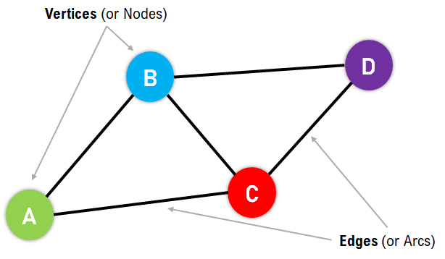
GRAPH READING
Graphs are data structures used to represent "connections" between pairs of elements.
These elements are called nodes. They represent real-life objects, persons, or entities.
The connections between nodes are called edges.

Slide 3
Dijkstra’s Alogrithmn
Dijkstra's Algorithm is a graph search algorithm that efficiently finds the shortest path from a single source node to all other nodes in a weighted graph. It is widely used in various applications such as GPS navigation systems, network routing protocols, and airline flight planning. It guarantees the shortest path and provides optimal results for graphs with non-negative edge weights. However, it doesn't work with graphs containing negative edge weights.

Slide 4
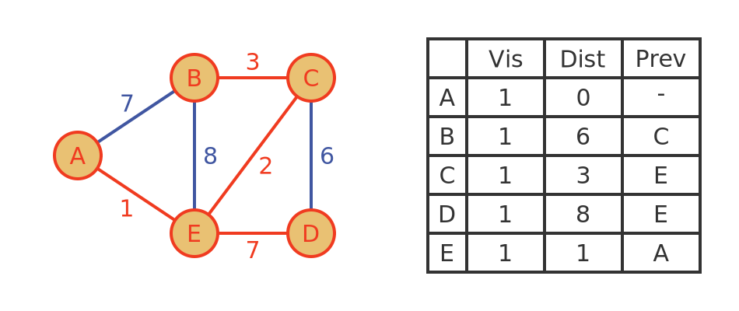
Finding the shortest Path using Dijkstra’s Alogrithmn

Slide 5
How it works
Initialization:
Start by setting the distance from the source node to itself as 0.
Initialize the distances from the source node to all other nodes as infinity.
Selection of Nodes:
Select the node with the smallest distance that hasn't been visited yet. This node becomes the current node.
Update Distances:
Update the distances to all adjacent nodes of the current node if the total distance through the current node is shorter than the existing distance.
Keep track of the shortest distance and the path leading to each node.
Mark as Visited:
Once all adjacent nodes are updated, mark the current node as visited.
Repeat Until Completion:
Repeat steps 2-4 until all nodes are visited or until the destination node is reached.

Slide 6
Minimum Spanning Tree Problem
A Minimum Spanning Tree (MST) is a fundamental concept in graph theory. It refers to the smallest tree that connects all the vertices of a graph without any cycles.
Key Characteristics:
Connectivity: The MST ensures that all vertices of the graph are connected.
Minimal Spanning Cost: The total weight of edges in the MST is minimized, making it the most cost-effective way to connect all vertices.

Slide 7
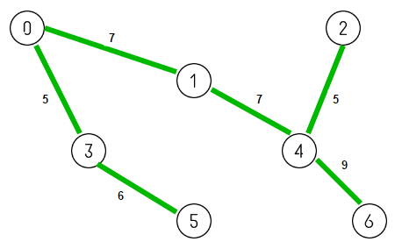
How it works
The problem starts with a connected, undirected graph. Each edge of the graph has an associated weight or cost, which may represent distances, time, or any other metric depending on the context of the problem.

Slide 8
Selecting Vertices:
The algorithm begins by selecting a starting vertex arbitrarily or based on some predefined rule. This vertex becomes the root of the MST.
Exploring Edges:
The algorithm explores the edges connected to the selected vertex. It identifies the edge with the lowest weight that connects to a vertex not yet included in the MST.
This process continues until all vertices are included in the MST, forming a connected tree without any cycles.
Building the MST:
As the algorithm progresses, it gradually builds the MST by adding edges with the lowest weights. These edges are selected in a way that ensures connectivity and minimizes the total weight of the tree.
Avoiding Cycles:
During the construction of the MST, it's crucial to avoid creating cycles. If an edge would create a cycle, it's skipped, and the algorithm proceeds to the next edge with the lowest weight.

Slide 9
Termination:
The algorithm terminates when all vertices are included in the MST, and there are no remaining edges to explore.
Examples of alogrithmns used to solve the minimum spanning tree problem.
Prim's Algorithm: This algorithm starts with an arbitrary vertex and greedily grows the MST one vertex at a time by selecting the edge with the lowest weight that connects to a vertex not yet in the tree.
Kruskal's Algorithm: This algorithm sorts all the edges of the graph by weight and incrementally adds edges to the MST, avoiding cycles. It ensures that the graph remains acyclic by only adding edges that connect two different connected components of the partially constructed MST.

